Slide 1
CS371m - Mobile Computing
2D Graphics
A Crash Course in Using (Android) 2D Graphics Libraries

Slide 2
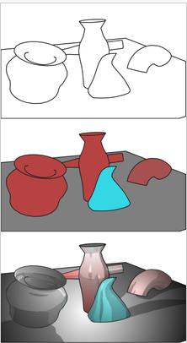
2D Graphics Crash Course
Render
Heating animal remains to extract fat
OR
generating an image from a (mathematical) model

Slide 3
Using Graphics
Not an end in itself
Create a richer, easier to use UI
Display information in a easier to understand way

Slide 4



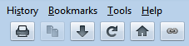
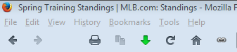
Richer UI
The (OLD) Apple Effect?

Slide 5
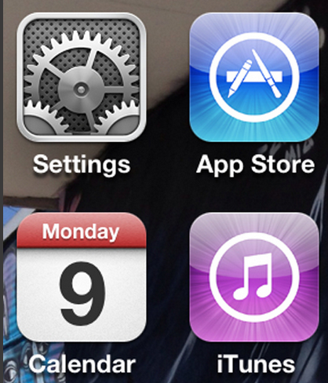
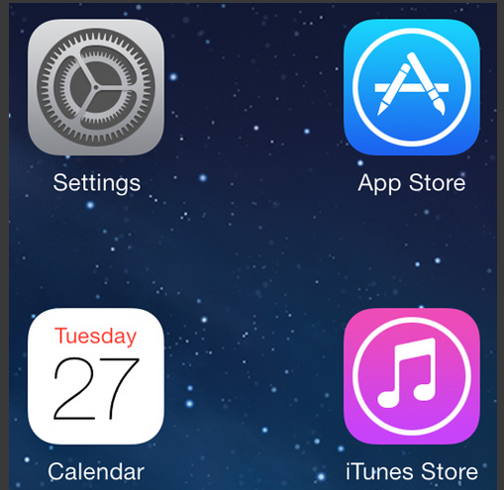
UI Design Changes
The (New) Apple Effect

Slide 6
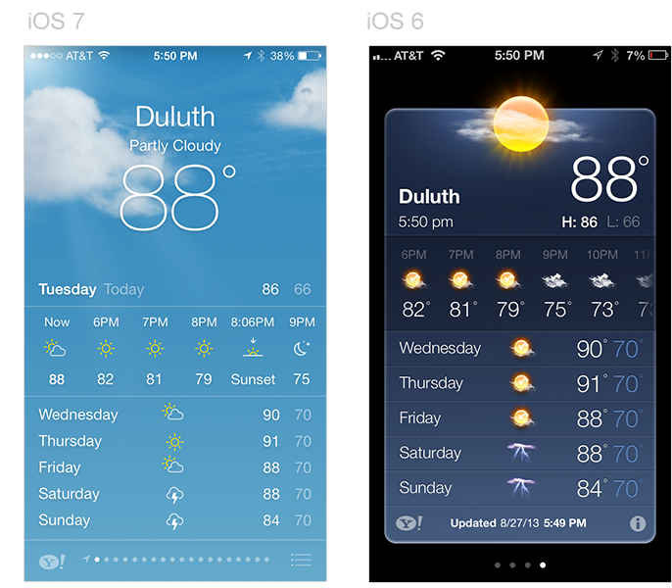
iOS 7 and iOs6

Slide 7
sidetrack on the visual display of information

Slide 8

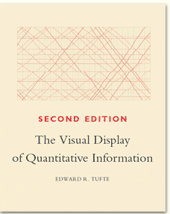
Visual Display of Information
Edward Tufte
Yale professor (poly sci, stats, and cs)
spark lines
small multiple
critical of PowerPoint

Slide 9
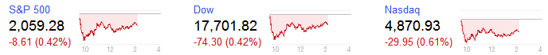
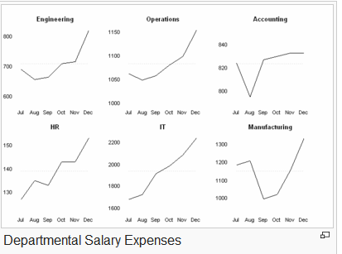
Visual Display
Spark Lines
Small Multiple

Slide 10
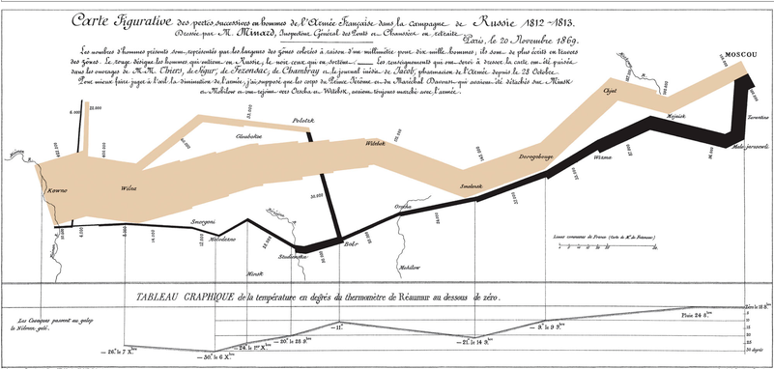
Joseph Minard Napoleon's Invasion of Russia
Location, size of army, data, temperature

Slide 11
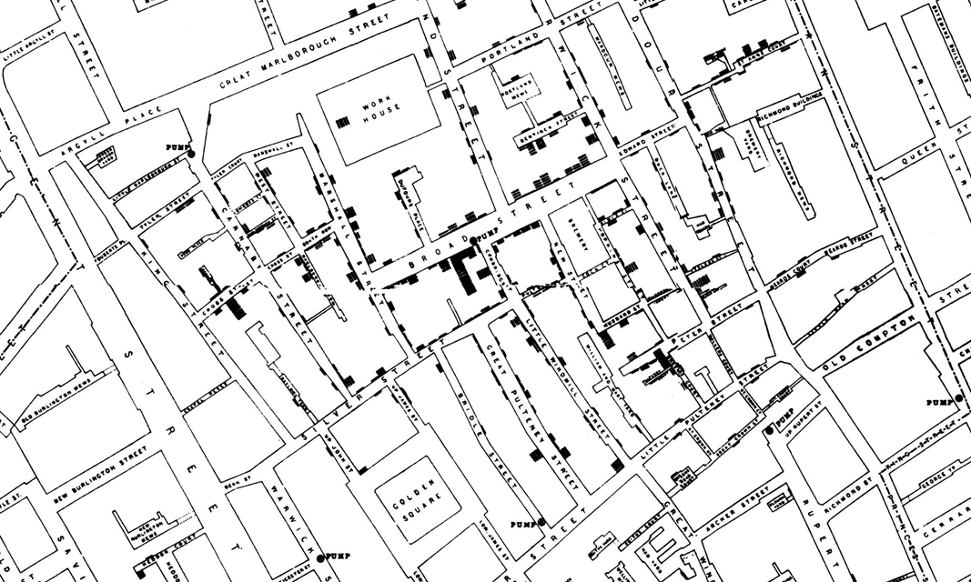
John Snow - Deaths from Cholera, 1854 Broad Street Outbreak (The Ghost Map)

Slide 12
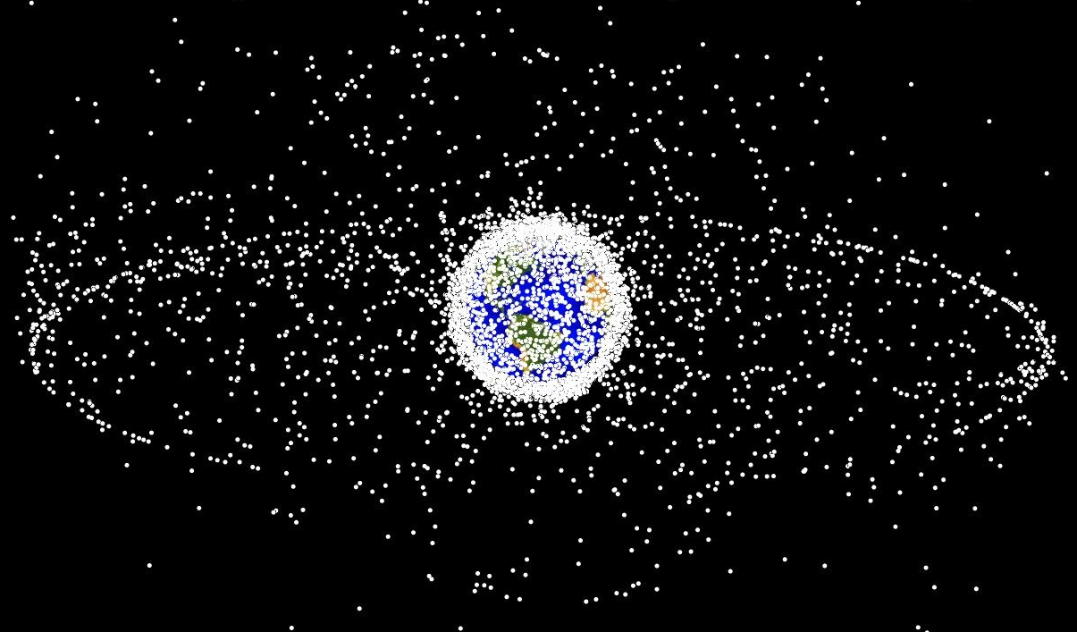
Space Debris Plot

Slide 13

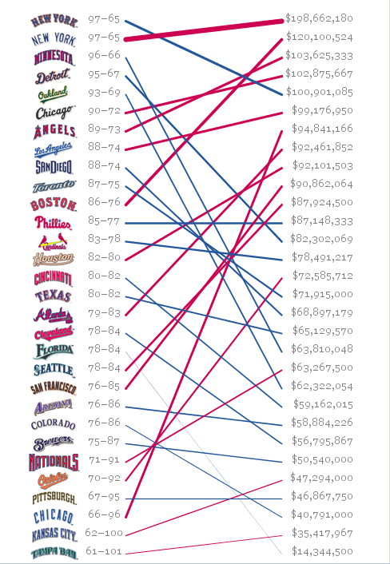

Visualizing Data
Ben Fry, one of the creators of Processing

Slide 14
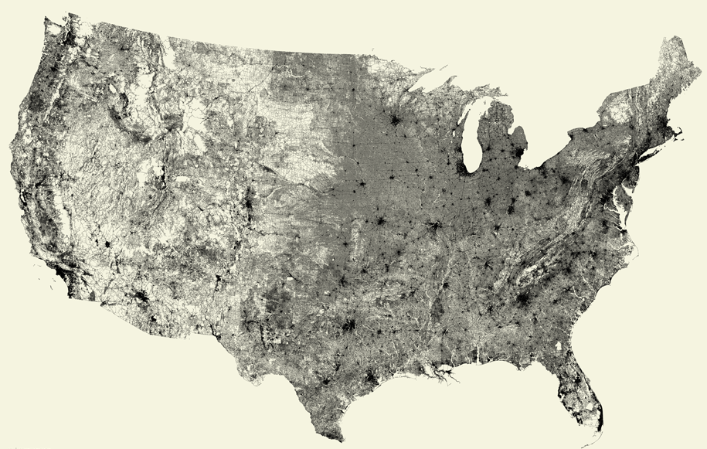
All Roads

Slide 15
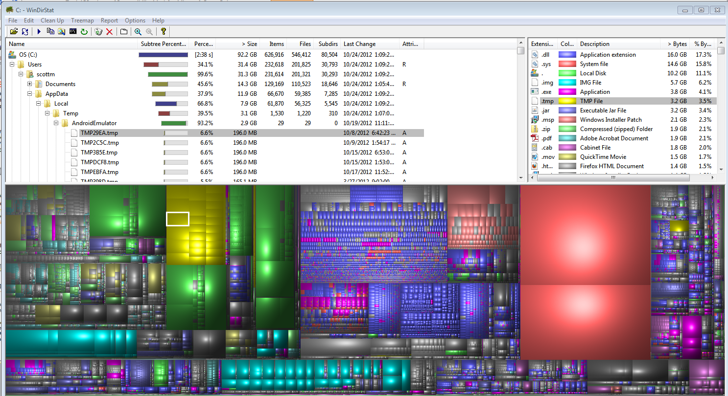
Files on Disk - WinDirStats

Slide 16
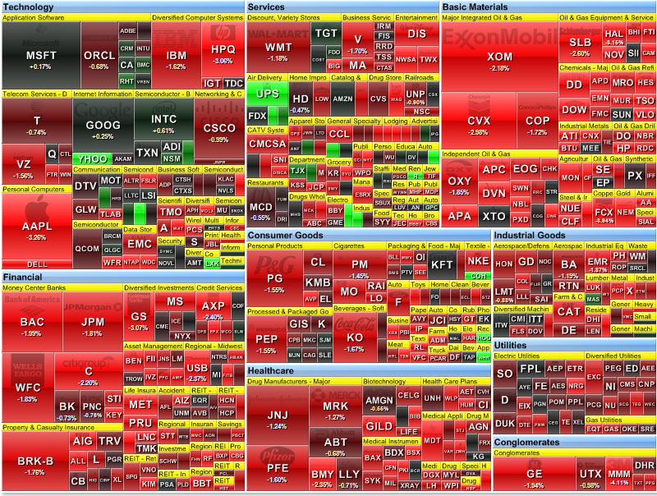
S&P 500 Heat Map

Slide 17
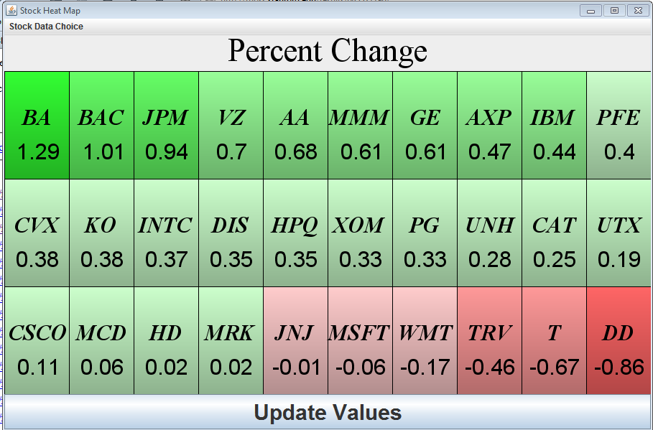
CS324E Heat Map

Slide 18
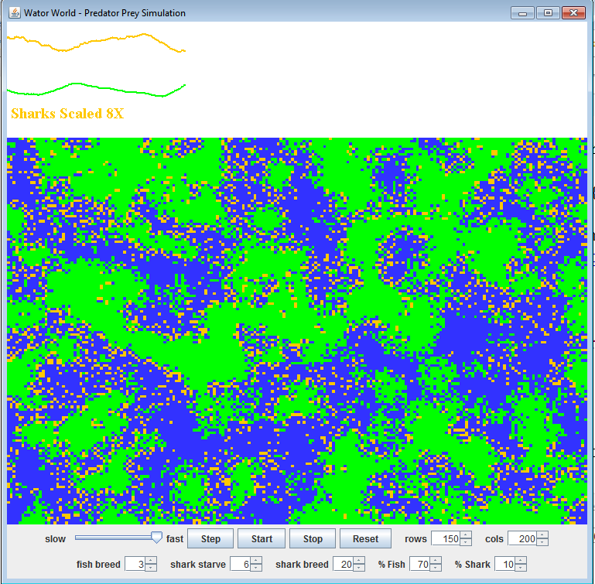
CS324E Wator World

Slide 19
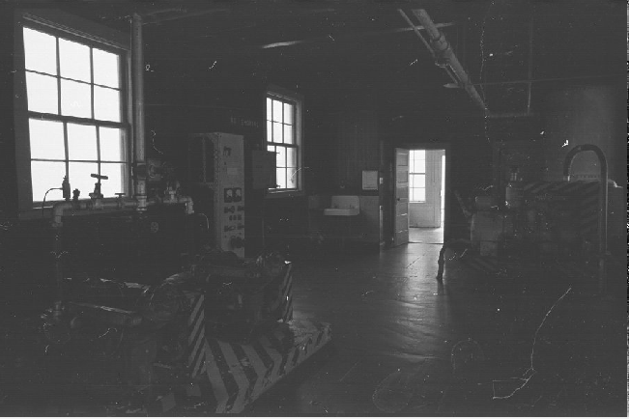
Image Processing

Slide 20
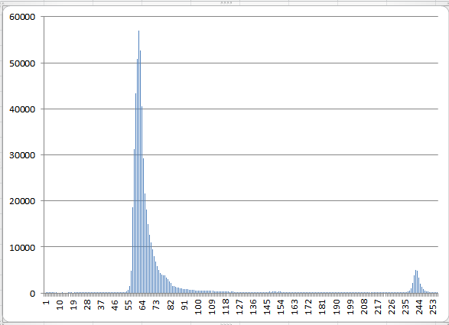
Color Histogram

Slide 21
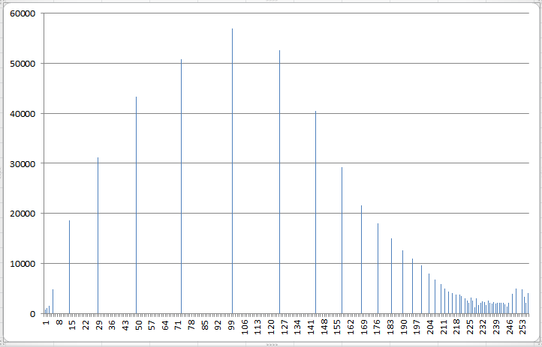
Histogram Equalization

Slide 22
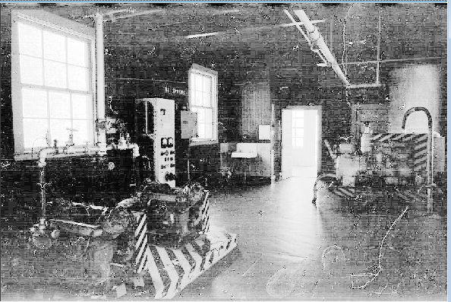
Revised Image

Slide 23


23

Slide 24
android 2d graphics

Slide 25
Android Graphics
NOT the Java awt or swing packages
custom set of classes
Canvas: class that holds code for various "draw" methods
Similar to Java Graphics, Graphics2D objects
Paint: Controls the drawing. A whole host of properties.
Bitmap: the things drawn on
Drawable: the thing to draw. (rectangles, images, lines, etc.)
Typeface: for fonts

Slide 26
Two Methods for Displaying 2D Graphics
Two approaches
draw graphics or animations into a View object that is part of layout
define graphics that go into View
simple approach for non dynamic graphics or simple "tweened" animations
Draw graphics directly to a Canvas
the complex way, but with more control

Slide 27
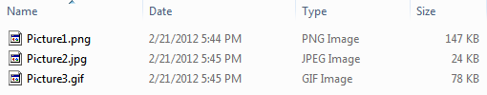
Simple Graphics
Use Drawables in Views
Create a folder res/drawable
Add images
png (preferred)
jpg (acceptable)
gif (discouraged)
Images can be added as background for Views

Slide 28
adding drawables to views

Slide 29
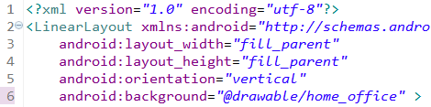
Adding Drawables to Views
Change background to an image
previously used background colors

Slide 30

Top Ten With Image Background

Slide 31

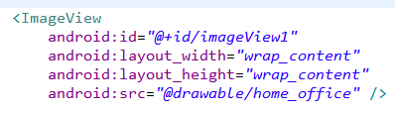
Add ImageView to Layout
In the main.xml for top ten

Slide 32

ImageView Attributes
scaleType: how image should be moved or resized in the ImageView
tint: affects color of image
more to position image in ImageView

Slide 33
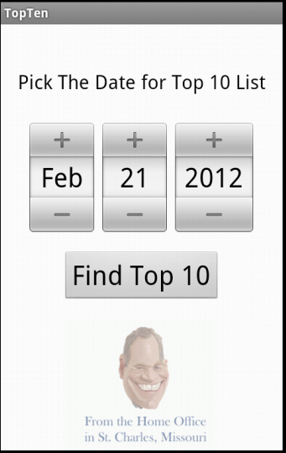
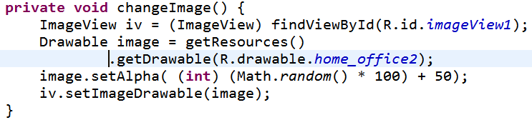
Changing ImageView Programmatically
Randomly set the alpha (transparency of the image)
Or pick an image randomly
Or set image based on month (Season)

Slide 34
drawing via a canvas

Slide 35
Using a Canvas
Simple way -> Create a custom View and override the onDraw method
The Canvas is a parameter to onDraw
Create a class that extends View
override the 2 parameter constructor
override the onDraw method
perform custom drawing in the onDraw method
add the View to the proper layout

Slide 36
Requesting Redraws of a View
call invalidate() on a View to redraw it
invalidate redraws the whole View
possible to redraw only a portion of the View, the part that changed
several overloaded versions of invalidate that accept a region of the View
only that portion redrawn
Override the onDraw method for the View to redraw
for really complex drawing and graphics move drawing off of the UI thread to a SurfaceView (more complex)

Slide 37
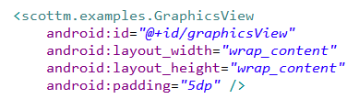
Simple Graphics Example Add CustomView to XML
in main.xml
add custom View as element in LinearLayout

Slide 38
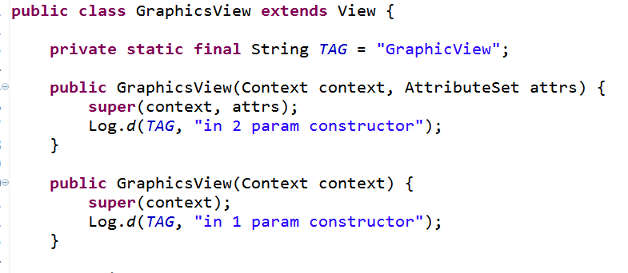
Simple Example - Graphics View

Slide 39
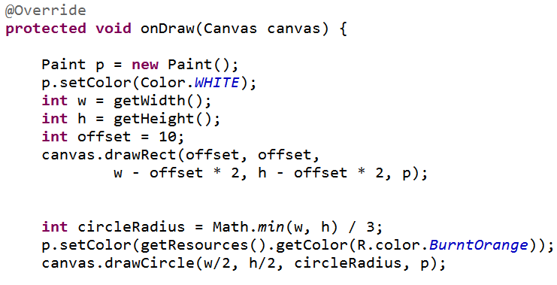
GraphicsView - onDraw

Slide 40
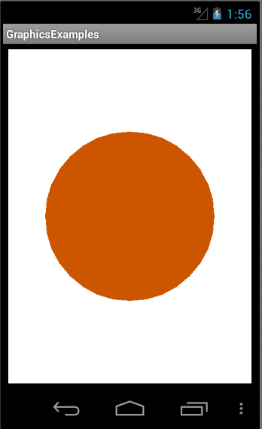
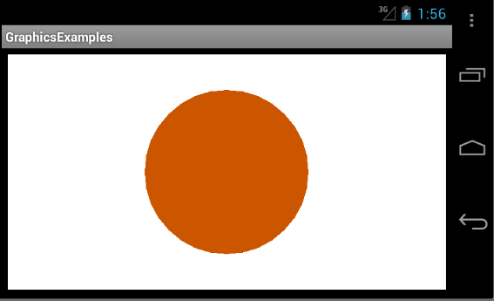
Simple Graphics Result

Slide 41
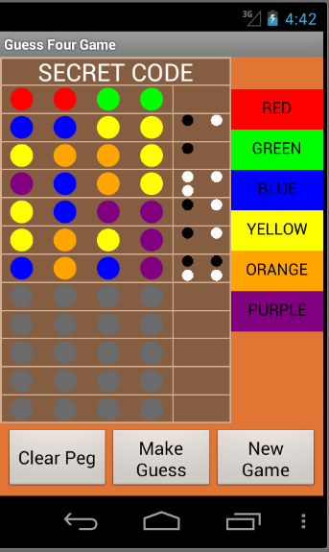
GuessFour
Board drawn in onDraw method of a View
Board will resize for different devices
lines, ovals, rectangles, and texts

Slide 42
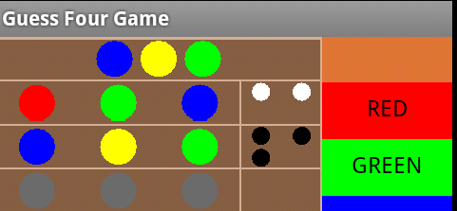
Paint
typically create Paint with anti aliasing enable
Paint p = new Paint(Paint.ANTI_ALIAS_FLAG);

Slide 43
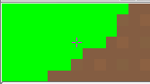
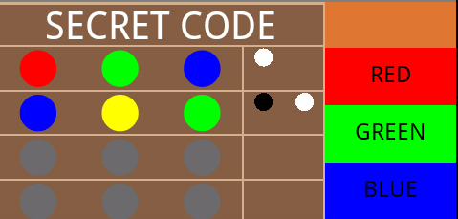
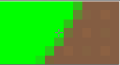
Anti Aliasing - The Jaggies

Slide 44
Using the Canvas Class
methods to draw:
rectangles
lines
arcs
paths
images
circles
ovals
points
text
and many more
Ability to set the "clip", portion of canvas where drawing takes place
commands to draw something that is outside clip are ignored
Ability to translate, rotate, and scale the canvas

Slide 45
Paint Object
many, many attributes and properties including:
current color to draw with
whether to fill or outline shapes
size of stroke when drawing
text attributes including size, style (e.g. underline, bold), alignment,
gradients

Slide 46
Gradients
3 kinds of gradients
LinearGradeint
RadialGradeint
SweepGradient
at least 2 color, but possibly more
flows from one color to another

Slide 47
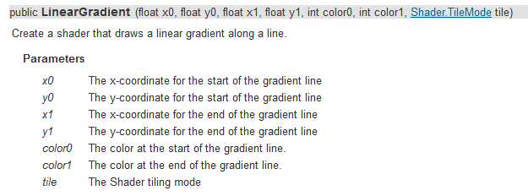
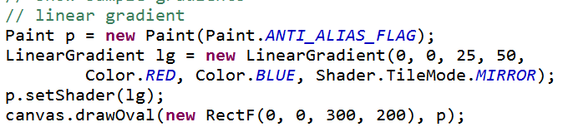
Linear Gradient

Slide 48
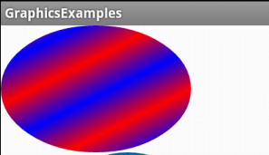
LinearGradient

Slide 49
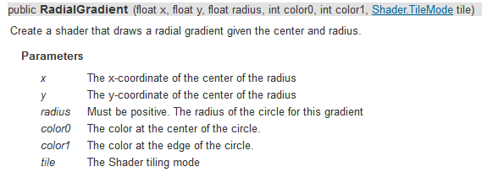
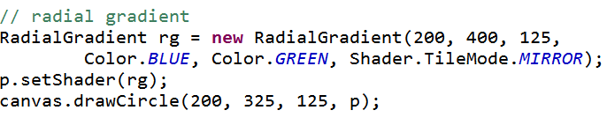
RadialGradient

Slide 50
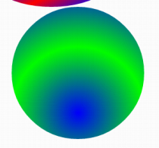
RadialGradient

Slide 51
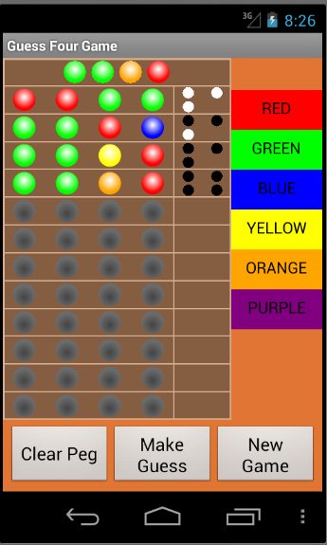
RadialGradeint
add depth to pegs and open spots in Guess Four game

Slide 52
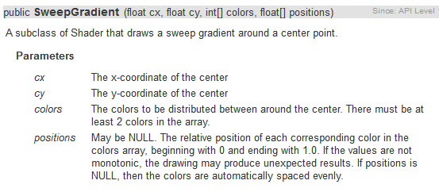
SweepGradient

Slide 53
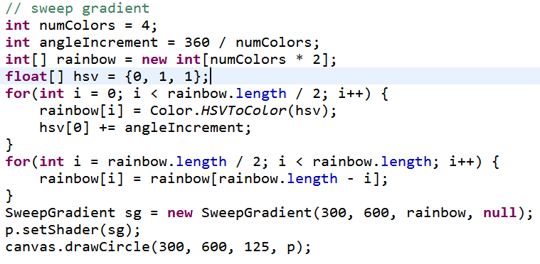
SweepGradient

Slide 54
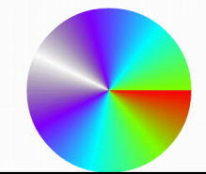
SweepGradient

Slide 55
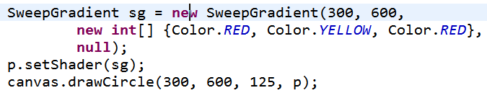
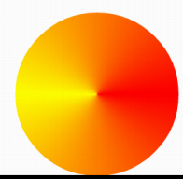
SweepGradient

Slide 56
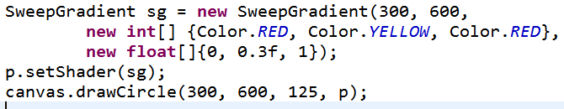

SweepGradient

Slide 57
Animation

Slide 58
Simple Animation
Animation altering some property of a 2D primitive
position
size
color
alpha
Simplest animation loop, after onDraw, call invalidate
at the mercy of the UI frame rate

Slide 59

Simple (And Poor) Animation Approach
draw as fast as possible
emulator frame rate (on my machine) 12 fps
dev device frame rate, high 50s fps

Slide 60

Better Animation Loop
Create a Handler to delay / sleep
update method will call sleep method on the Handler

Slide 61

update method
animation loop
update tells handler to sleep
handler calls update when it wakes up …

Slide 62
tweened AnimationS

Slide 63
Simple Animations
Tweened Animations
also know as View Animations
provide a way to perform simple animations on Views, Bitmaps, TextViews, Drawables
provide start point, end point, size, rotation, transparency, other properties
Can set up tweened animation in XML or programmatically

Slide 64
Tweened Animations
Used to alter one of four properties of a single Drawable resource
Bitmap graphic (image), shape, TextView, any View (background)
Tweened animations can affect
Alpha (transparency / opaqueness)
Rotation
Scale (size)
Location (movement, Translate)

Slide 65
Tweened Animations
define interpolator in XML (optional)
allow animation to be repeated, accelerate, decelerate, "bounce", and more
can use built in interpolators or create your own
define animation in XML
alpha, rotate, scale, translate
define from value, to value, and duration
In program load and start animation in response to some event
Guess Four, invalid choice, solved puzzle

Slide 66


Guess Four res/anim
shake up down
shake left right

Slide 67


GuessFour res/anim
cycle_7.xml
spin.xml

Slide 68


GuessFour Example
On error board shakes back and forth
On win board spins
From BoardView in GuessFour

Slide 69

More Tweened Examples
hyperspace example from android dev site
rotate and change alpha
animation types:
alpha
scale
translate
rotate
http://developer.android.com/guide/topics/resources/animation-resource.html

Slide 70


More Tweened Examples
Moving Button
Note, tweened animations draw the button in a different spot
But, the button's location is not really changed

Slide 71

Up and Down Animation

Slide 72

Moving Button Activity
Use extra from Intent to determine what type of animation to perform.

Slide 73

Tweened Animation

Slide 74

Change Background Color
Called when button clicked
onClick attribute
Result?

Slide 75
property animations -Available POST GINgerbread

Slide 76
Property Animations
A more general animation framework
Tweened Animations can only affect alpha, scale, rotation, and position
Property Animations can affect any property of an object
typically a View or Drawable
can be defined in sets, change multiple properties at a time
animation created separate from target object, reuse with different objects
http://developer.android.com/guide/topics/graphics/prop-animation.html

Slide 77
Property Animation - Classes
ValueAnimator
base class for property animations
Object Animator
convenience class for animating specific object and property
ViewPropertyAnimator
optimized, simple animation of View objects
evaluator classes such as ArgbEvaluator to animate property by defining how it changes over time

Slide 78

Some Animations Simple
API levels 12+
View objects have animate() method
ViewPropertyAnimator
methods for alpha, rotation, scale (size), translation (position)

Slide 79

ViewPropertyAnimator Example
onClick method for a button:
button will disappear and then reappear next time clicked

Slide 80

More Complex Property Animation
Object animation
from moving button example
animated class must have a "set<Property>" method

Slide 81


Button Class
How does the Object Animator change the y value?

Slide 82

ObjectAnimator

Slide 83
??????
How can the ObjectAnimator call the right methods on the object passed?
Declared type is Object
must be calling setY method, right?
Discover reflection

Slide 84
A Sidetrack on Reflection

Slide 85
Reflection
Advanced feature of Java.
Commonly used by programs that "examine or modify the runtime behavior of applications running in the Java virtual machine"
The Android Property Animation framework uses reflection

Slide 86
Why Reflection
Extensible features
like Android Property Animator framework
Class Browsers and Visual Development Environments
Debugger and Testing Tools
am I testing all the public methods?
coverage

Slide 87
Recall: Property Animation
ObjectAnimator class a subclass of ValueAnimator
Convenience class for property animation
When animator created set animation time, property to animate, and the starting and ending values
"The constructors of this class take parameters to define the target object that will be animated as well as the name of the property that will be animated. Appropriate set/get functions are then determined internally and the animation will call these functions as necessary to animate the property. "

Slide 88

ObjectAnimator Example
Button class must have gety and sety methods that return and accept a float
ofFloat, ofInt, ofObject, ofMulti…

Slide 89

Object Animator
How does the Object animator affect the y value of the Button?
Recall Java, declared type, actual type
What methods does allow compiler allow?
Not a button

Slide 90
Class objects
Everything in Java a primitive (byte, short, int, long, float, double, char, boolean) or an Object
arrays and Enums are Objects
The Java virtual machine instantiates an immutable instance of java.lang.Class for every type of Object necessary in a running program
Entry point for reflection

Slide 91

Getting the Class object

Slide 92
Accessing Internals
Class object may be used to access fields, methods, and constructors
… including private members
methods that enumerate members and methods that search for a member given a name
Like a spy

Slide 93
Security
This appears to be dangerous stuff
The ability to find out about private methods and fields
… and even change them
Thus many of the methods in the Class class and Reflection API throw SecurityExceptions
If a SecurityManager is present and permission for reflection is not granted, exceptions occur
"If you remove this sticker, the warranty is void"

Slide 94


Enumerating Fields

Slide 95


Enumerating Methods

Slide 96

Calling Methods

Slide 97

Calling Methods

Slide 98

Results of Method Calls - Animate!

Slide 99


And Then the Unthinkable Happened

Slide 100
Recall Button Class
x is private
no methods to access or alter x
YIKES

Slide 101


But final is safe, right????
String fields in Java 8

Slide 102

Result of changeString
We are good right?

Slide 103

Oh the Humanity

Slide 104

Client Code

Slide 105

Result

Slide 106
rendering with complex calculations

Slide 107
More Complex Graphics
Don't want apps to become unresponsive
If complex graphics or animation use SurfaceView class
Main view not waiting on onDraw to finish
secondary thread with reference to SurfaceView
SrufaceView draws and when done display result

Slide 108
Using a SurfaceView
extend SurfaceView
implement SurfaceHolder.Callback
methods to notify main View when SurfaceView is created, changed or destroyed

Slide 109

Simple Example
Static Screen
continuously draw several hundred small rectangles (points, with stroke = 10)
slowly fill screen and then keep changing

Slide 110

Implement SurfaceHolder.Callback methods

Slide 111

Prevent Runaway Threads!

Slide 112

Inner Class for Thread

Slide 113

Run Method in StaticThread
Standard Approach for Drawing on SurfaceView

Slide 114

Demo run()
Pronounced flicker and jitter
Double buffer under the hood
We are drawing on two different Bitmaps
Canvas does drawing onto Bitmap

Slide 115

Remove Flicker / Jitter
If we draw background each "frame" then we don't redraw previous rectangles
How about "saving" all the data?
points, colors

Slide 116
Alternative
Recall two approaches:
draw on UI thread by overriding onDraw
create custom View (tutorial 4)
okay if not a lot of drawing
must keep UI thread responsive
complex drawing or animations using SurfaceView
Third approach, possible variation on the above two approaches
maintain a separate Bitmap

Slide 117

Separate Bitmap
StaticThread has a Bitmap instance var
Initialize in constructor

Slide 118

Updates to Bitmap
Create a
Canvas to draw on
the Bitmap
we are
saving
When done drawing to Bitmap use SurfaceView Canvas to draw

Slide 119

Demo Alt Version of run()
Flicker and jitter?
Also possible to save Bitmap to file for later use

Slide 120

Animations
Frame based vs. Time based
Frame based:
update every frame
simple, but difference in frame rates
Time based
update every frame but based on time elapsed since last frame
more work, more accurate
sdk example lunar lander

Slide 121

Checking Frame Rate
From StaticView
Emulator 6-7 fps, dev phone 40 -45 fps

Slide 122

Controlling Frame Rate
Sleep after completing work in loop of run
More complex than shown, use previous time and current time

